Slide 1
Dota 2 Game Prediction
By: Jeffrey Walls and Ethan Smith

Slide 2
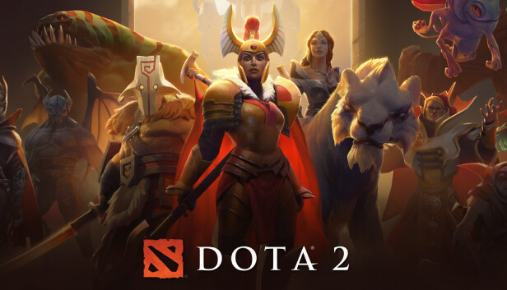
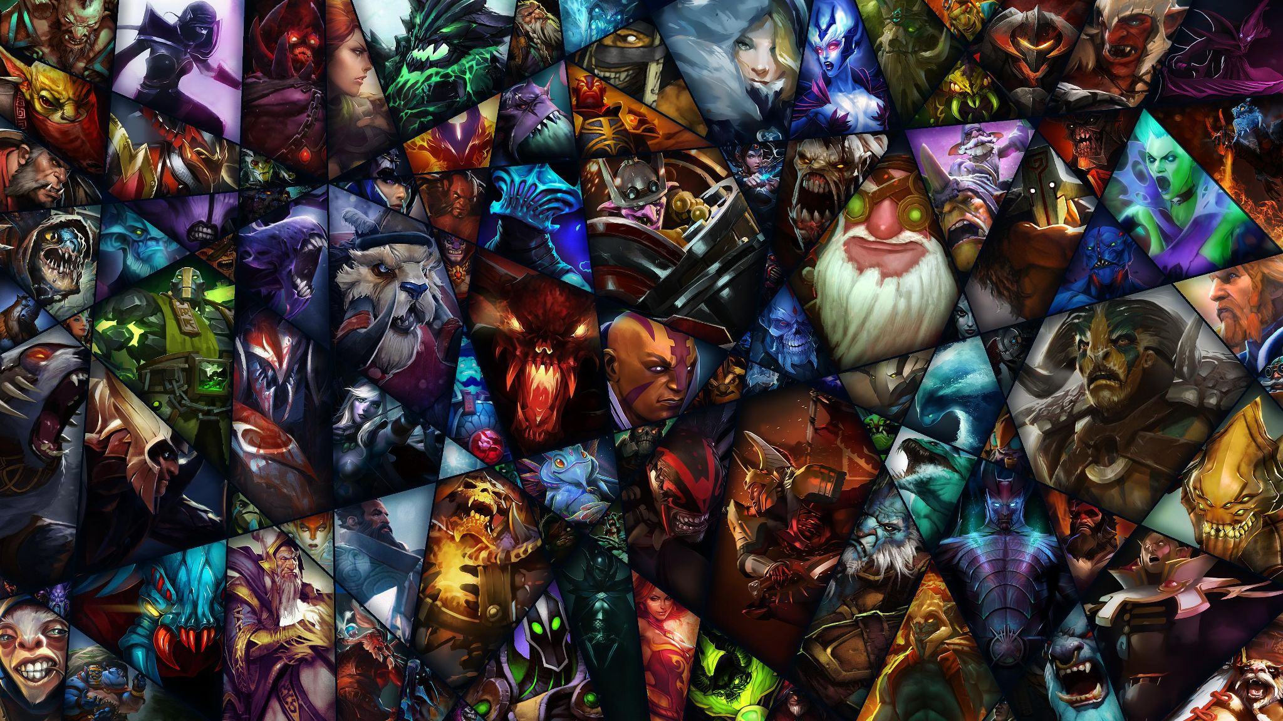
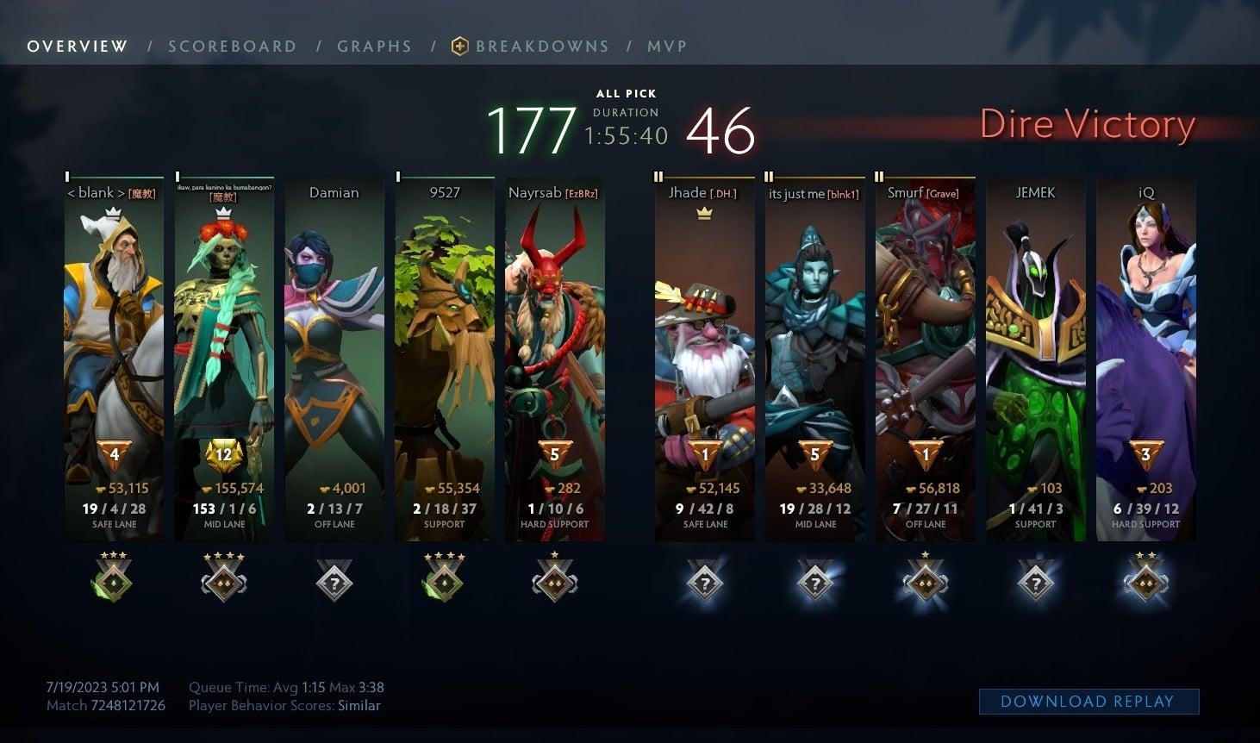

Slide 3
Our Model
K-Nearest Neighbors (KNN)
First based on the code from Assignment 2
For each champion missing on a team added 1 to the distance
Assumes each champion is equally important to the team
Takes into account whether the teams are swapped in the dataset.

Slide 4
Dataset
102944 Matches
113 Different Champions each either a 1 for blue team, -1 for red team, or 0 if they weren’t played in that match
Released August 13th, 2016
Collected using
https://gist.github.com/da-steve101/1a7ae319448db431715bd75391a66e1b

Slide 5
Data Cleansing
Columns 2, 3, and 4 had irrelevant data regarding the location, game mode, and whether the match was ranked or not
Multiplied the columns from 5+ by the winner of the match and removed the first 5 columns to get just get the winning comp and the losing comp

Slide 6
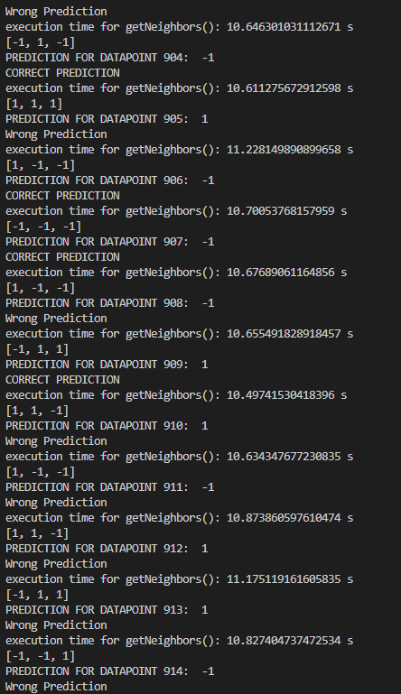
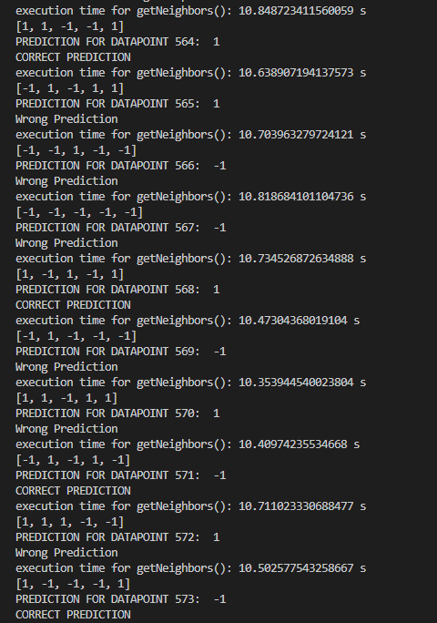
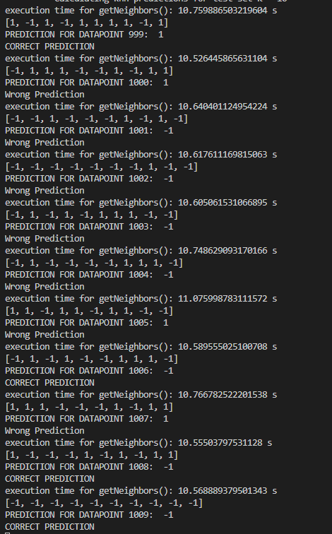
Results
50% Accurate
52% Accurate
48% Accurate

Slide 7
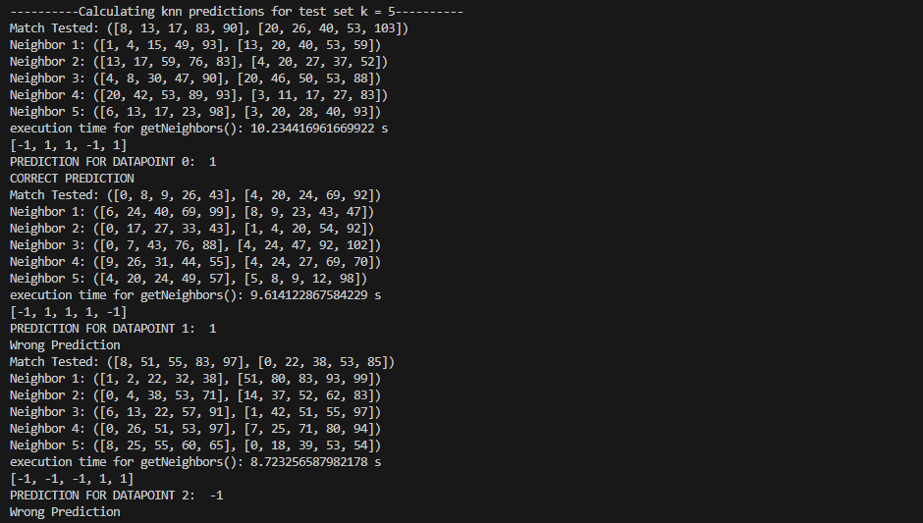
Results (Cont.)

Slide 8
What we could have done differently
Come to you for help
Only used ranked games
Lessens the impact of skill
Try to use the collecting tool to get more modern data
Not extremely important, but would help with researching the balance of the game
Apply the model to a game we are more familiar with, League of Legends

Slide 9
Improvements/Future Options
Different distance for each role that was changed
Keep track of champions % in each role, creating another tool to predict which champions are in which role
Original Idea for team comp suggestions
Take in more data about a games state, gold earned per team, kills, objectives, etc.
Turn the model into a live prediction for which team will win

Slide 10
References
https://archive.ics.uci.edu/dataset/367/dota2+games+results

Slide 11
Thank You

